Slide 1










Towards Open-Domain Conversational AI
Yun-Nung (Vivian) Chen 陳縕儂
Http://vivianchen.idv.tW

Slide 2
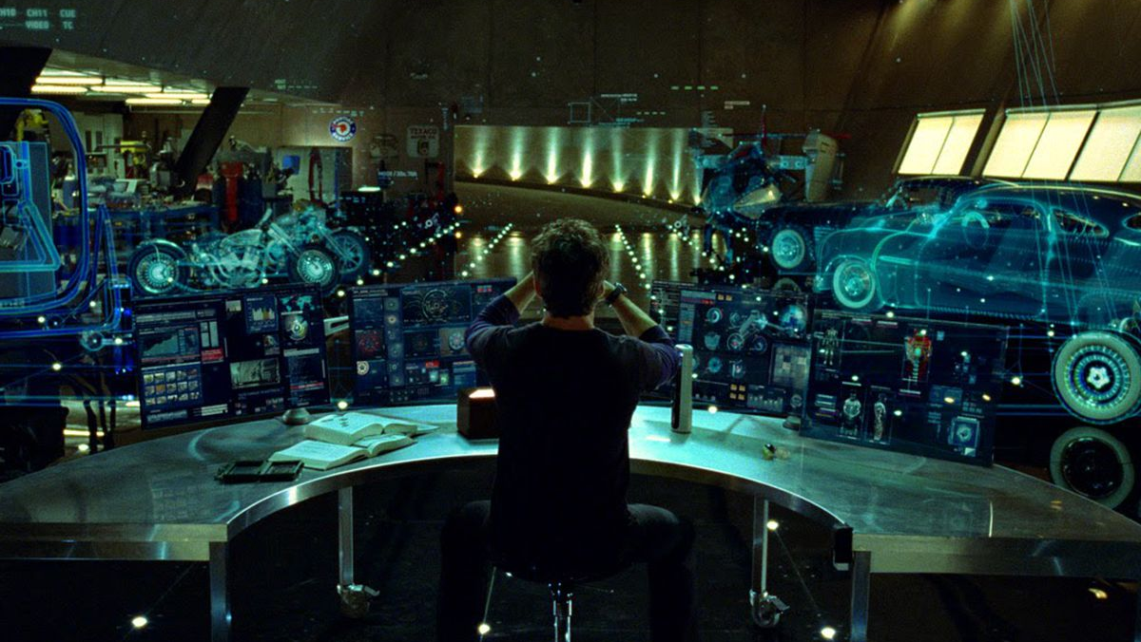
Iron Man (2008)
What can machines achieve now or in the future?

Slide 3
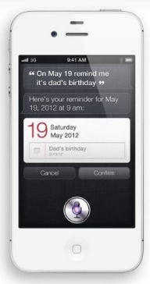
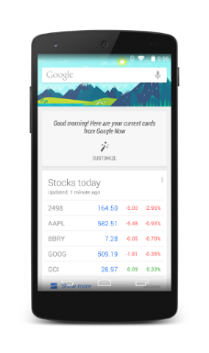
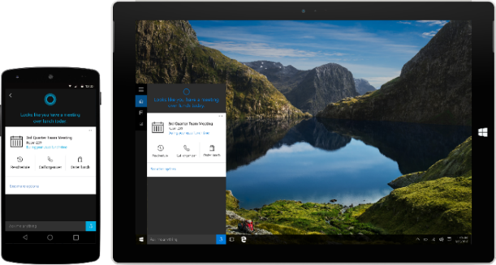
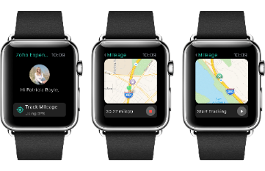
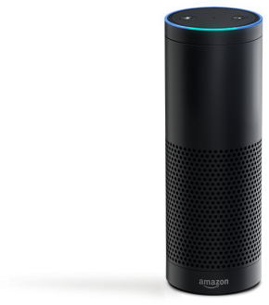

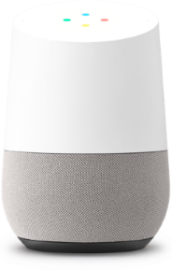
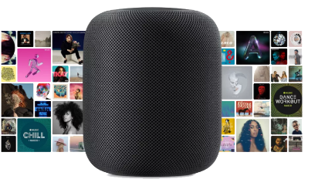
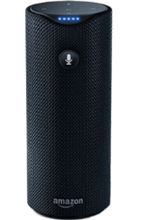
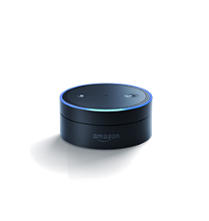
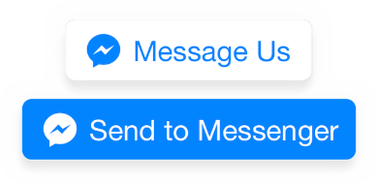
Language Empowering Intelligent Assistants
Apple Siri (2011)
Google Now (2012)
Microsoft Cortana (2014)
Google Assistant (2016)
Amazon Alexa/Echo (2014)
Facebook M & Bot (2015)
Google Home (2016)
Apple HomePod (2017)

Slide 4
Why and When We Need?
“I want to chat”
“I have a question”
“I need to get this done”
“What should I do?”
Turing Test (talk like a human)
Information consumption
Task completion
Decision support
Social Chit-Chat
Task-Oriented Dialogues
What is today’s agenda?
What does SLT stand for?
Book me the flight ticket from Taipei to Athens
Reserve a table at Din Tai Fung for 5 people, 7PM tonight
Is SLT conference good to attend?
Notes:
General goal, of course involves treating natural language as a knowledge representation language. So MR involves deriving structured information from free text, and then doing something with it.
But the work that’s been done in this space represents a tangle of different agendas. Let’s unpack them a bit.
Where does it make sense for MS to focus its efforts in this space?
For 1, doesn’t drive mainstream AI research. Hobby strand, though maybe good for PR purposes. Not a good driver of research/product.
For 2 & 3 the user already has some idea of what the information need is.
For 4, the user is overwhelmed by the complexity of the problem/solution space, needs help navigating.

Slide 5
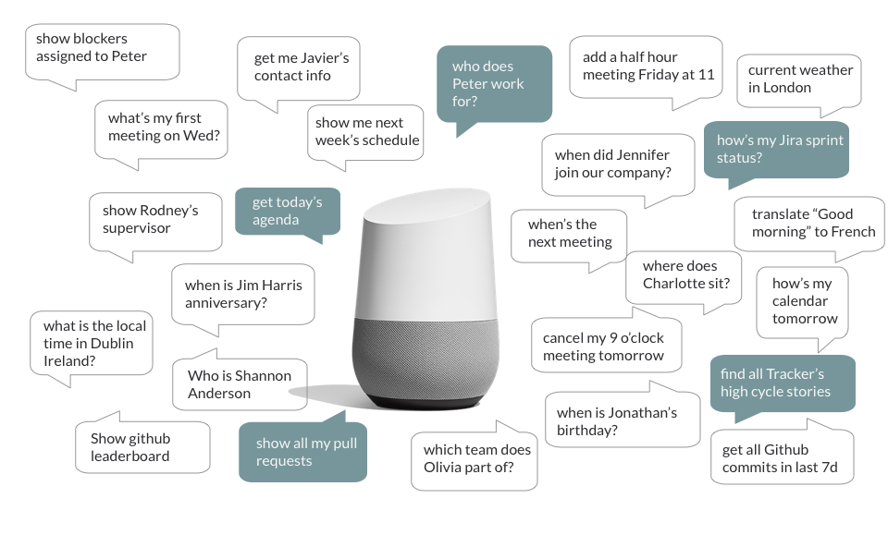




Intelligent Assistants
Task-Oriented

Slide 6
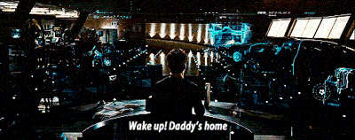

Task-Oriented Dialogue Systems
JARVIS – Iron Man’s Personal Assistant
Baymax – Personal Healthcare Companion

Slide 7
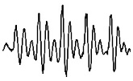

Task-Oriented Dialogue Systems (Young, 2000)
Speech Signal
Hypothesis
are there any action movies to see this weekend
Language Understanding (LU)
Domain Identification
User Intent Detection
Slot Filling
Speech Recognition
Text Input
Are there any action movies to see this weekend?
Semantic Frame
request_movie
genre=action, date=this weekend
Dialogue Management (DM)
Dialogue State Tracking (DST)
Dialogue Policy
Natural Language Generation (NLG)
Text response
Where are you located?
System Action/Policy
request_location
Backend Database/ Knowledge Providers

Slide 8
Task-Oriented Dialogue Systems (Young, 2000)
Speech Signal
Hypothesis
are there any action movies to see this weekend
Language Understanding (LU)
Domain Identification
User Intent Detection
Slot Filling
Speech Recognition
Text Input
Are there any action movies to see this weekend?
Semantic Frame
request_movie
genre=action, date=this weekend
Dialogue Management (DM)
Dialogue State Tracking (DST)
Dialogue Policy
Natural Language Generation (NLG)
Text response
Where are you located?
System Action/Policy
request_location
Backend Database/ Knowledge Providers

Slide 9
Language Understanding (LU)
Pipelined
1. Domain Classification
2. Intent Classification
3. Slot Filling

Slide 10
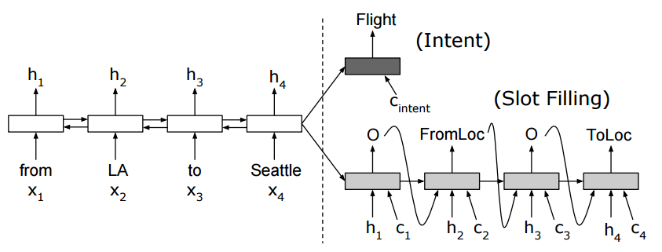
Joint Semantic Frame Parsing
Sequence-based (Hakkani-Tur et al., 2016)
Slot filling and intent prediction in the same output sequence
Parallel (Liu and Lane, 2016)
Intent prediction and slot filling are performed in two branches
taiwanese
food
please
EOS
U
U
U
U
h_{t-1}
h_{t}
h_{t+1}
h_{T+1}
W
W
W
W
V
V
V
V
B-type
O
O
FIND_REST
Slot Filling
Intent Prediction

Slide 11
Joint Model Comparison
 | Attention Mechanism | Intent-Slot Relationship
Joint bi-LSTM | X | Δ (Implicit)
Attentional Encoder-Decoder | √ | Δ (Implicit)
Slot Gate Joint Model | √ | √ (Explicit)

Slide 12
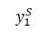
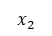
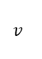
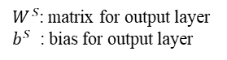
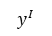
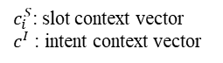
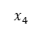
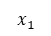
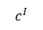
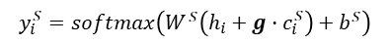

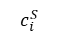
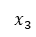
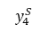
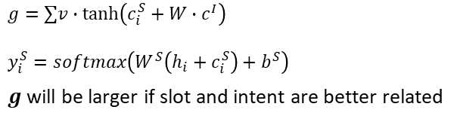
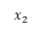
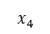
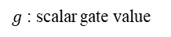
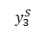
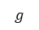
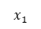
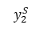
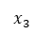
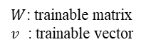
Slot-Gated Joint SLU (Goo et al., 2018)
Slot Sequence
$$y_{1}^{S}$$
$$y_{2}^{S}$$
$$y_{3}^{S}$$
$$y_{4}^{S}$$
$$g$$
∑
Slot Gate
$$y^{I}$$
∙
$$v$$
Intent Attention
Slot Attention
BLSTM
tanh
BLSTM
Word Sequence
+
∙
$$W$$
$$x_{1}$$
$$x_{2}$$
$$x_{3}$$
$$x_{4}$$
Word Sequence
$$x_{1}$$
$$x_{2}$$
$$x_{3}$$
$$x_{4}$$
$$c_{i}^{S}$$
$$c^{I}$$
$W^{S}$: matrix for output layer
$b^{S}$ : bias for output layer
$c_{i}^{S}$: slot context vector
$c^{I}$ : intent context vector
Slot Gate
Slot Prediction
$$g=∑v∙\tanh\left(c_{i}^{S}+W∙c^{I}\right)$$
$$y_{i}^{S}=softmax\left(W^{S}\left(h_{i}+c_{i}^{S}\right)+b^{S}\right)$$
$g$ will be larger if slot and intent are better related
$$y_{i}^{S}=softmax\left(W^{S}\left(h_{i}+g∙c_{i}^{S}\right)+b^{S}\right)$$
$W$: trainable matrix
$v$ : trainable vector
$g$ : scalar gate value

Slide 13

Contextual Language Understanding
Single Turn
U
just sent email to bob about fishing this weekend
S
O
O
O
O
O
B-contact_name
B-subject
I-subject
I-subject
→ send_email(contact_name=“bob”, subject=“fishing this weekend”)
U₁
send email to bob
Multi-Turn
S₁
B-contact_name
→ send_email(contact_name=“bob”)
U₂
are we going to fish this weekend
S₂
B-message
I-message
I-message
I-message
I-message
I-message
I-message
→ send_email(message=“are we going to fish this weekend”)

Slide 14
E2E MemNN for Contextual LU (Chen et al., 2016)
U: “i d like to purchase tickets to see deepwater horizon”
S: “for which theatre”
U: “angelika”
S: “you want them for angelika theatre?”
U: “yes angelika”
S: “how many tickets would you like ?”
U: “3 tickets for saturday”
S: “What time would you like ?”
U: “Any time on saturday is fine”
S: “okay , there is 4:10 pm , 5:40 pm and 9:20 pm”
0.69
0.13
0.16
U: “Let’s do 5:40”

Slide 15


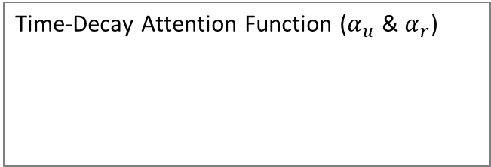

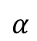

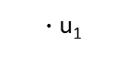
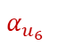
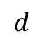
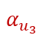

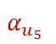
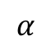

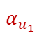
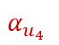
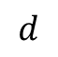
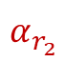




Role-Based & Time-Aware Attention (Su et al., 2018)
$$α_{u_{i}}$$
Sentence-Level Time-Decay Attention
Time-Decay Attention Function ($α_{u}$ & $α_{r}$)
u₁
$$α$$
convex
$$α$$
linear
$$α$$
concave
u₂
u₃
Tourist
u₄
Guide
u₅
$$d$$
$$d$$
$$d$$
u₆
u₇
Current
…
w_{t}
w_{t+1}
…
w_{T}
Spoken Language Understanding
$$α_{u_{2}}$$
$∙$u₄
$∙$u₅
$$α_{u_{3}}$$
$$α_{u_{6}}$$
$∙$u₂
$$α_{u_{4}}$$
$$α_{u_{5}}$$
$$α_{u_{1}}$$
$∙$u₆
Dense Layer
$∙$u₁
$∙$u₃
History Summary
$$α_{r_{1}}$$
$$α_{r_{2}}$$
Role-Level Time-Decay Attention
+
Dense Layer
Time-decay attention significantly improves the understanding results

Slide 16
Task-Oriented Dialogue Systems (Young, 2000)
Speech Signal
Hypothesis
are there any action movies to see this weekend
Language Understanding (LU)
Domain Identification
User Intent Detection
Slot Filling
Speech Recognition
Text Input
Are there any action movies to see this weekend?
Semantic Frame
request_movie
genre=action, date=this weekend
Dialogue Management (DM)
Dialogue State Tracking (DST)
Dialogue Policy
Natural Language Generation (NLG)
Text response
Where are you located?
System Action/Policy
request_location
Backend Action / Knowledge Providers

Slide 17

Dialogue Policy Optimization
Dialogue management in a RL framework
User
Environment
Natural Language Generation
Language Understanding
Action A
Reward R
Observation O
Dialogue Manager
Agent
Select the best action that maximizes the future reward

Slide 18







E2E Task-Completion Bot (TC-Bot) (Li et al., 2017)
w_{i}
w_{i+1}
EOS
w_{i}
w_{i+1}
EOS
NLG
Natural Language
LU
w_{i}
w_{i+1}
EOS
w₀
w₁
w₂
EOS
<slot>
O
<intent>
Are there any action movies to see this weekend?
<slot>
O
<intent>
<slot>
O
<intent>
Knowledge Database
DST
User Goal
$$s_{t}$$
Dialogue Policy
Dialogue Policy Learning
User Model
$$s_{1}$$
$$s_{2}$$
……
$$s_{n}$$
Neural Dialogue System
User Simulation
request_location
$$a_{1}$$
$$a_{2}$$
…
$$a_{k}$$
Idea: SL for each component and RL for end-to-end training the neural dialogue system

Slide 19
Reinforcement Learning Agent (Li et al., 2017)
User goal – Two tickets for “Deadpool” tomorrow 9PM at AMC Pacific Place 11 theater, Seattle.
RULE BASED SYSTEM
User: Do you have any ticket for movie ‘Deadpool’ at 9:00 pm?
Agent: Which theater do you want?
User: AMC pacific place 11 theater, please!
Agent: How many tickets do you want?
User: Two!
Agent: What date?
User: Tomorrow!
Agent: Which city do you want?
User: Seattle!
Agent: Do you have any specification for zip code?
User: No, I do not care.
Agent: Do you have any distance constraint?
User: No, I do not care.
Agent: How about video format? 2d? Imax 3d?
User: Any kind is okay.
Agent: Do you have any constraint to price?
User: No!
Agent: Okay, I will issue 2 tickets for you, tomorrow 9:00 pm at AMC pacific place 11 theater, Seattle, movie ‘Deadpool’.
User: Okay, thanks.
Agent: Thanks!
REINFORCEMENT LEARNING SYSTEM
User: I want two tickets for movie ‘Deadpool’.
Agent: What is the starttime you prefer?
User: 9:00 PM
Agent: Which day?
User: Tomorrow
Agent: Which city?
User: Seattle
Agent: Which theater do you prefer? User: AMC Pacific Place 11 theater.
Agent: Okay, I will issue 2 tickets for you, tomorrow 9:00 pm at AMC pacific place 11 theater, Seattle, movie ‘Deadpool’.
User: Okay, thanks.
Agent: Thanks!
no notion about what requests can be skipped
Skip the requests the user may not care about to improve efficiency

Slide 20
RL in Dialogue Systems
Sample inefficient, hard to design reward function, local optima…
Real users are expensive
Discrepancy between real users and simulators

Slide 21
D3Q: Discriminative Deep Dyna-Q (Su et al., 2018)
Idea
learning with real users with planning
add a discriminator to filter out the bad experiences
Real Experience
Semantic Frame
Human Conversational Data
Imitation
Learning
NLU
DST
Supervised
Learning
Simulated Experience
Controlled Planning
Discriminator
Discriminator
Policy Model
Acting
State Representation
Discriminative Training
Direct Reinforcement Learning
World Model
User
User
World Model
NLG
Policy Learning
Real
Experience
World Model
Learning
System Action (Policy)

Slide 22


D3Q: Discriminative Deep Dyna-Q (Su et al., 2018)
The policy learning is more robust and shows the improvement in human evaluation
S.-Y. Su, X. Li, J. Gao, J. Liu, and Y.-N. Chen, “Discriminative Deep Dyna-Q: Robust Planning for Dialogue Policy Learning," (to appear) in Proc. of EMNLP, 2018.

Slide 23
Task-Oriented Dialogue Systems (Young, 2000)
Speech Signal
Hypothesis
are there any action movies to see this weekend
Language Understanding (LU)
Domain Identification
User Intent Detection
Slot Filling
Speech Recognition
Text Input
Are there any action movies to see this weekend?
Semantic Frame
request_movie
genre=action, date=this weekend
Dialogue Management (DM)
Dialogue State Tracking (DST)
Dialogue Policy
Natural Language Generation (NLG)
Text response
Where are you located?
System Action/Policy
request_location
Backend Action / Knowledge Providers

Slide 24
Natural Language Generation (NLG)
Mapping dialogue acts into natural language
inform(name=Seven_Days, foodtype=Chinese)
Seven Days is a nice Chinese restaurant

Slide 25
Issues in Neural NLG
Issue
NLG tends to generate shorter sentences
NLG may generate grammatically-incorrect sentences
Solution
Generate word patterns in a order
Consider linguistic patterns

Slide 26



Hierarchical NLG w/ Linguistic Patterns (Su et al., 2018)
GRU Decoder
Near All Bar One is a moderately priced Italian place it is called Midsummer House
…
is
a
moderately
…
1. Repeat-input 2. Inner-Layer Teacher Forcing
3. Inter-Layer Teacher Forcing
4. Curriculum Learning
DECODING LAYER4
4. Others
…
…
All Bar One is moderately priced Italian place it is called Midsummer House
last output $y_{t−1}^{i}$
All Bar One
is
a
…
is
…
output from last layer $y_{t}^{i−1}$
All Bar One
moderately
DECODING LAYER3
3. ADJ + ADV
Bidirectional GRU Encoder
All Bar One is priced place it is called Midsummer House
…
…
DECODING LAYER2
2. VERB
name
Italian
priceRange
Semantic 1-hot Representation
[ … 1, 0, 0, 1, 0, …]
All Bar One place it Midsummer House
$$h_{\text{enc}}$$
Input Semantics
name[Midsummer House], food[Italian], priceRange[moderate], near[All Bar One]
ENCODER
DECODING LAYER1
1. NOUN + PROPN + PRON
Hierarchical Decoder
26

Slide 27
Evolution Roadmap
I feel sad…
I’ve got a cold what do I do?
Dialogue depth (complexity)
Tell me a joke.
Single domain systems
Extended systems
Multi-domain systems
Open domain systems
What is influenza?
Dialogue breadth (coverage)

Slide 28









Dialogue Systems
Understanding (NLU)
State tracker
input x
Task-Oriented Dialogue
DB
Database
Memory
External knowledge
Generation (NLG)
Dialog policy
output y
Statistical model (e.g., neural)
Understanding (NLU)
State tracker
input x
Fully Data-Driven
DB
Generation (NLG)
Dialog policy
output y
28

Slide 29
Chit-Chat Social Bots

Slide 30

Neural Response Generation (Sordoni et al., 2015; Vinyals & Le, 2015)
Source: conversation history
… because
of
your
game?
EOS
Yeah
I’m
on
my
encoder
decoder
Target: response
Yeah
I’m
on
my
way
Learns to generate dialogues from offline data (no state, action, intent, slot, etc.)
Notes:
The MT approach promising, but in 2014 we switched to neural models, and in particular LSTM models which have very successful in other areas.
We train sequence models to learn the mapping between an entire conversation history to a response to generate.
We’ve done work models and objective functions that work well with conversation, and on metrics.
Don’t have much time to get into technical details, but let’s focus on one particular problem.

Slide 31


Issue 1: Blandness Problem
Wow sour starbursts really do make your mouth water... mm drool. Can I have one?
Of course!
Milan apparently selling Zlatan to balance the books... Where next, Madrid?
I don’t know.
32% responses are general and meaningless “I don’t know” “I don’t know what you are talking about” “I don’t think that is a good idea” “Oh my god”
‘tis a fine brew on a day like this! Strong though, how many is sensible?
I'm not sure yet, I'll let you know !
Well he was on in Bromley a while ago... still touring.
I don't even know what he's talking about.
Notes:
Here are sample outputs of the standard LSTM, and you can see that for the same queries, responses are very bland. And actually, the four most common deflective responses constitute 32% of the output.

Slide 32
MMI for Response Diversity (Li et al., 2016)
Wow sour starbursts really do make your mouth water... mm drool. Can I have one?
Of course you can! They’re delicious!
Milan apparently selling Zlatan to balance the books... Where next, Madrid?
I think he'd be a good signing.
‘tis a fine brew on a day like this! Strong though, how many is sensible?
Depends on how much you drink!
Well he was on in Bromley a while ago... still touring.
I’ve never seen him live.
Notes:
Captures common sense inferences.

Slide 33


Issue 2: Response Inconsistency

Slide 34






Personalized Response Generation (Li et al., 2016)
D_Gomes25
Jinnmeow3
u.s.
london
skinnyoflynny2
england
TheCharlieZ
great
Rob_712
good
Tomcoatez
Dreamswalls
Speaker embeddings (70k)
Bob_Kelly2
Word embeddings (50k)
Kush_322
monday
live
okay
kierongillen5
This_Is_Artful
tuesday
stay
The_Football_Bar
DigitalDan285
where
do
you
live
Rob
EOS
Rob
in
Rob
england
Rob
.
in
england
.
EOS

Slide 35


Persona Model for Speaker Consistency (Li et al., 2016)
Baseline model → inconsistency
Persona model using speaker embedding → consistency

Slide 36







Issue 3: Dialogue-Level Optimization via RL
Language understanding
$$s$$
Dialogue
Manager
$$a=π(s)$$
Collect rewards
$$(s, a, r, s’)$$
User input (o)
Language (response) generation
$$a$$
Optimize
$$Q(s,a)$$
Response
Application | State | Action | Reward
Task Completion Bots (Movies, Restaurants, …) | User input + Context | Dialog act + slot-value | Task success rate # of turns
Info Bots (Q&A bot over KB, Web etc.) | Question + Context | Clarification questions, Answers | Relevance of answer # of turns
Social Bot (XiaoIce) | Conversation history | Response | Engagement(?)

Slide 37

Deep RL for Response Generation (Li et al., 2016)
Input message
Supervised Learning Agent
Reinforcement Learning Agent
RL agent generates more interactive responses
RL agent tends to end a sentence with a question and hand the conversation over to the user

Slide 38
Issue 4: No Grounding (Sordoni et al., 2015; Li et al., 2016)
Neural model learns the general shape of conversations, and the system output is situationally appropriate and coherent.
No grounding into a real calendar, but the “shape” of the conversation is fluent and plausible.
H: hi
M: how are you?
H: not bad
M: what's wrong?
H: nothing really
M: wanna talk about it? i 'm here if you
wanna talk
H: well, i'm just tired
M: me too, i'm here if you wanna talk
H: would thursday afternoon work sometime?
M: yeah , sure . just let me know when you‘re free.
H: after lunch is probably the best time
M: okay, sounds good . just let me know when
you‘re free.
H: would 2 pm work for you?
M: works for me.
H: well let‘s say 2 pm then i ‘ll see you there
M: sounds good.

Slide 39

Chit-Chat v.s. Task-Oriented
Social Chat
Engaging, Human-Like Interaction (Ungrounded)
Task-Oriented
Task Completion, Decision Support (Grounded)
The weather is so depressing these days.
I know, I dislike rain too.
What about a day trip to eastern Washington?
Any recommendation?
Try Dry Falls, it’s spectacular!
39

Slide 40
Knowledge-Grounded Responses (Ghazvininejad et al., 2017)
Going to Kusakabe tonight
Dialogue Encoder
Σ
Decoder
Try omakase, the best in town
Conversation History
Response
Fact Encoder
Consistently the best omakase
Amazing sushi tasting […]
.
A
They were out of kaisui […]
.
.
.
.
.
World “Facts”
Contextually-Relevant “Facts”

Slide 41
Conversational Agents
Seq2seq models
Seq2seq with conversation contexts
Knowledge-grounded seq2seq models
Chit-Chat
Single-domain, system-initiative
Multi-domain, contextual, mixed-initiative
End-to-end learning, massively multi-domain
Task-Oriented

Slide 42
Evolution Roadmap
Empathetic systems
I feel sad…
I’ve got a cold what do I do?
Common sense system
Dialogue depth (complexity)
Tell me a joke.
What is influenza?
Knowledge based system
Dialogue breadth (coverage)

Slide 43









High-Level Intention Learning (Sun et al., 2016; Sun et al., 2016)
High-level intention may span several domains
Schedule a lunch with Vivian.
find restaurant
check location
contact
play music
What kind of restaurants do you prefer?
The distance is …
Should I send the restaurant information to Vivian?
Users interact via high-level descriptions and the system learns how to plan the dialogues

Slide 44




Empathy in Dialogue System (Fung et al., 2016)
Embed an empathy module
Recognize emotion using multimodality
Generate emotion-aware responses
text
speech
vision
Emotion Recognizer

Slide 45
Challenges and Conclusions

Slide 46
Challenge Summary
Most state-of-the-art technologies are based on DNN
Requires huge amounts of labeled data
Several frameworks/models are available
Fast domain adaptation with scarse data + re-use of rules/knowledge
Handling reasoning and personalization
Data collection and analysis from un-structured data
Complex-cascade systems requires high accuracy for working good as a whole
The human-machine interface is a hot topic but several components must be integrated!

Slide 47

Her (2013)
What can machines achieve now or in the future?

Slide 48

Thanks for Your Attention!
Q & A
Yun-Nung (Vivian) Chen
Assistant Professor
National Taiwan University
y.v.chen@ieee.org / http://vivianchen.idv.tw

